Slide 1
Teamwork Transformation Using Teams

Slide 3
Students: How to View this Presentation
Switch to Notes Page view
Click View on the ribbon and select Notes Page
Use page up or page down to navigate
Zoom in or out as needed
Most slides will have supporting text that you can view now or after the delivery
Add notes to your copy of the presentation if you want to
You take the presentation files home with you

Slide 4
Objective
This module will show the users how to transform their Teams into a groupified structure and use in conjunction with their portal development for collaboration sites using Microsoft Teams. This area covers the assessment of sites, strategies to use in order to teamify sites, and execution of those strategies and extending to all sites in your corporation.

Slide 5




Modern Workplace Opportunity
Be able to take full advantage of Microsoft 365 Modern Workplace collaboration scenarios.
Specifically, by enabling SharePoint and Microsoft Team-connected experiences.
We will use a systematic approach to this including: Assessment, Strategy Design, Execution Support and ongoing support
Assessment
Strategy design
Execution support
Ongoing support & value expansion
Assessing SPO classic versus modern team site usage
Defining high value collaboration sites and corresponding stakeholder groups
Enabling classic to modern site transformations
Extending approach to additional team sites

Slide 6
Assessment and Strategy

Slide 7
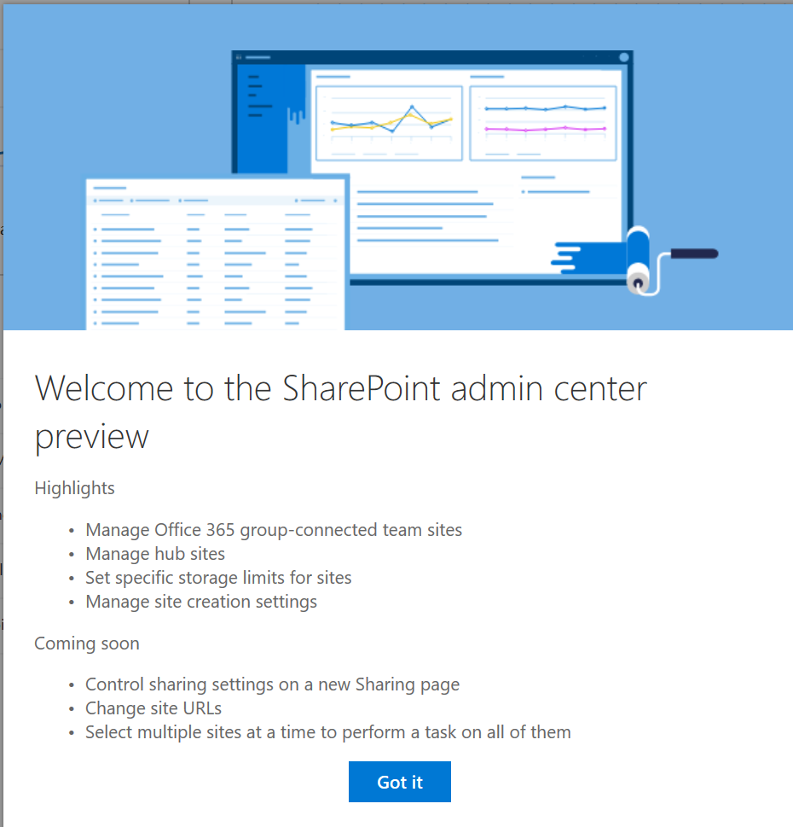
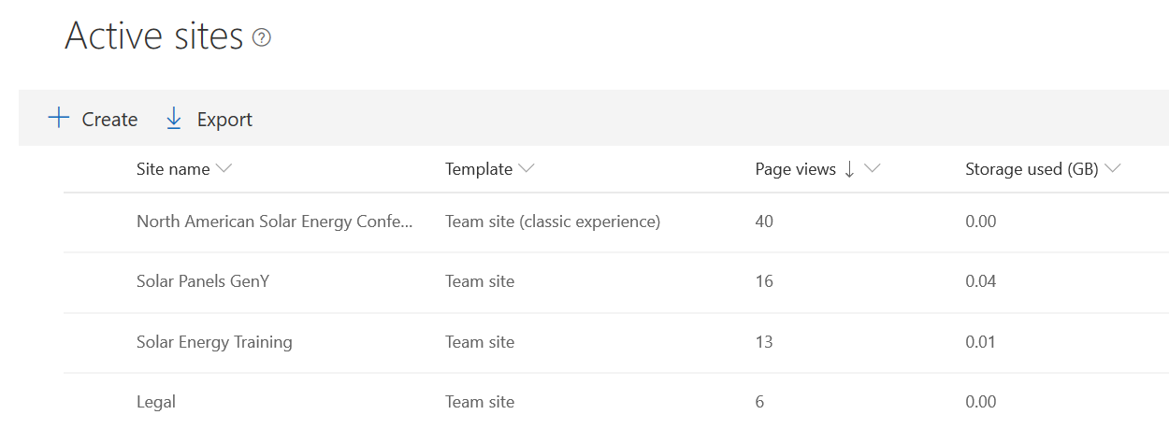
Assessment of current modernization candidates
Identify top classic site modernization candidates
Leverage the modern SharePoint admin experience
Sort on Template type, to distinguish between modern and classic experiences
Engage with stakeholders to discuss transition
Leverage business value discussion materials
End User Awareness materials available in FastTrack Resource Hub
2
1
Notes:
End User Awareness materials available in FastTrack Resource Hub

Slide 8
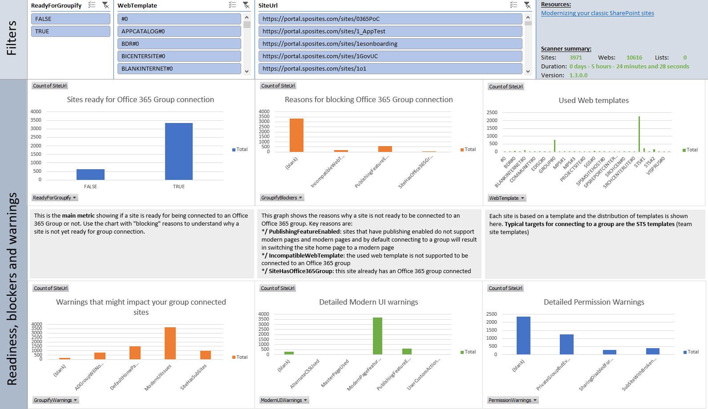
Transformation Readiness
Assess transformation readiness with Modernization Scanner
Sample group connection readiness scan results
Focus on following opportunity spaces:
Optimizing usage of modern list and libraries
Connecting sites to an Office 365 group
Modernizing wiki and web part pages by creating modern site pages
Notes:
The main purpose of this tool is to give you a set of reports that you can use to:
- Assess which sites are ready for "groupify": this report will give you "groupify" warnings and blockers which you can use to scope the sites to "groupify" and plan the needed remediation work
- Understand which lists are not showing up in modern, why that's the case and what you can do about them
- Learn more about the site pages used in your tenant: knowing which pages you have and their characteristics (type, layout, web part data, usage) is important to prepare for modernizing (a subset of) these pages
Tool location along with additional guidance: https://github.com/SharePoint/sp-dev-modernization/tree/master/Tools/SharePoint.Modernization

Slide 9
Execution

Slide 10
Modernize Classic Sites Guidance

Slide 11
Modernize Classic Sites guide
Start with the Modernizing your classic SharePoint sites guide
Modernize Classic Sites Guide
Connect to an Office 365 group
Modernize site branding
Connect to a Microsoft Team
Transform site pages
Notes:
https://docs.microsoft.com/en-us/sharepoint/dev/transform/modernize-classic-sites is the key entry point for all this content
Enable Modern Experiences:
The most visible aspect of a modern site is its modern user interface. Ensure the following tenant level setting is enabled in the SharePoint tenant admin center: SharePoint Lists and Libraries experience setting in the tenant admin center.
https://docs.microsoft.com/en-us/sharepoint/dev/transform/modernize-userinterface-lists-and-libraries
Connect to an Office 365 Group:
https://docs.microsoft.com/en-us/sharepoint/dev/transform/modernize-connect-to-office365-group
Modernize Site Branding:
https://docs.microsoft.com/en-us/sharepoint/dev/transform/modernize-branding
Transform Site pages:
https://docs.microsoft.com/en-us/sharepoint/dev/transform/modernize-userinterface-site-pages
Connect to a Microsoft Team details covered here:

Slide 12
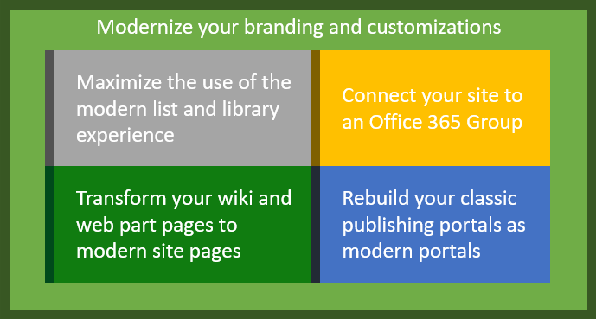
Modernize your classic SharePoint sites
With in-place modernization: you can fully transform (or "modernize") a classic site into a modern Microsoft 365 group-connected site by following the guidance in this section. Modernizing your sites involves one or more of the below steps:

Slide 13
Fully leverage the modern user interface
The most visible aspect of a modern site is its modern user interface. If you haven't turned off the modern experience, certain pages appear in the modern user interface:
List and library pages for most lists and libraries
Site contents page
Site usage page
Recycle Bin pages
However, if you navigate your site, you will notice that the following pages still use the classic user interface:
Home page and all other site pages (wiki pages and/or web part pages)
List and library pages for certain lists and libraries
Tools to Modernize
To maximize the use of the modern user interface for your site pages and list and library pages, see Modernize the user interface.
To learn more about how to unblock your lists and libraries when using the modern user interface, see Maximize use of modern lists and libraries.
You will also need to modernize your customizations as explained in Modernize customizations.
Notes:
To maximize the use of the modern user interface for your site pages and list and library pages, see Modernize the user interface.
To learn more about how to unblock your lists and libraries when using the modern user interface, see Maximize use of modern lists and libraries.
You will also need to modernize your customizations as explained in Modernize customizations.

Slide 14
Modernize the user interface
To make the switch to a modern user interface, you need to focus on the following:
Transitioning your lists and libraries to use the modern user interface (also referred to as the modern list and library experience)
Transforming your site pages from classic wiki and web part pages into modern pages
Notes:
Discussion Questions:
Where do you start when you want to modernize the user interface of your sites?
What sites should be modernized first?
This will be used as key questions to help with the three step process as outlined next.

Slide 15



Step 1: Identify and Educate Stakeholders
Key Business Stakeholders
Customization team and developers
Sharepoint Administrators
Change Management and Governance teams
Notes:
Key business stakeholders - The modern user interface must meet the needs of the business user, and the key business stakeholders should be advocates of this change. Granting them access to a playground environment and closely working with them will help them understand what works well and what doesn't. Later on, these key business stakeholders will play a crucial role in helping your end-users adopt the modern user interface.
Customization team and developers - Because customizations built in the past may no longer work in the modern user interface, this team needs to be available to redesign those customizations.
SharePoint administrators - The admins will be the ones that enable the modern user interface across your tenant and its sites.
Change management and governance teams - If these teams exist in your organization, they should be looped in as well because switching from the classic user interface to the modern user interface impacts change for users, and might require an update of internal training materials.

Slide 16
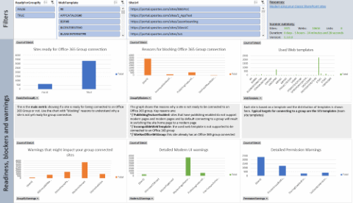
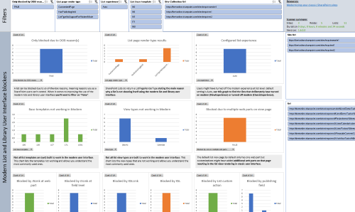
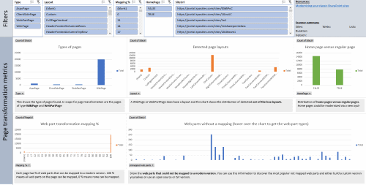
Step 2: Analyze your site collections
The SharePoint Modernization scanner provides a detailed analysis of your site's readiness for connecting to a Microsoft 365 group, helps you get a deep understanding of the modern user interface compatibility of your lists and libraries and also performs a detailed analysis of the wiki and web part pages in your environment to prepare you for a page modernization. These outcomes can be used initially to drive remediation work, followed later on by migration work. If your focus is to transform your site pages, to transform your lists and libraries or to connect your sites to a Microsoft 365 group then use this scanner.
Group connected readiness
List Readiness
Page Readiness
Notes:
Discussion: Your company tenant might contain thousands of site collections, so which of these site collections are good candidates to modernize and which aren’t?

Slide 17
Step 3: Modernize your site collections--Customizations
Replace
Replace incompatible customizations with equivalents that work in a modern user interface. Following are some samples. For more information, see Modernize customizations.
Replace
Replace JSLink with a column formatter or with a SharePoint Framework Field Customizer extension.
Replace
Replace existing first-party web parts with SharePoint Framework web parts in case there's no out-of-the-box modern web part available that provides similar capabilities.
Replace
Replace JavaScript embedding via user custom actions with a SharePoint Framework Application Customizer extension.
Replace
Replace list commands (user custom actions) with SharePoint Framework ListView Command Set extensions.

Slide 18
Step 3: Modernize your site collections—User Experience
Enabling lists and libraries to show in the modern user interface by replacing customizations, removing incompatible columns from the used views, or (as a last resort) moving data into a modern user interface-compatible list type.
Connecting your site to a Microsoft 365 group, which gives your site a modern home page and enables your site to use, for example, a mailbox or Microsoft Planner, which then enables you to use a modern version of a calendar and task list.
Creating modern pages and configuring these to be "similar" to your key classic wiki and web part pages. Programmatic page transformation should be done for the key pages of your sites; transforming all pages is resource-intensive and often not needed. To assist in this triage, the SharePoint Modernization scanner can give you usage information about the current wiki and web part pages.

Slide 19

Step 3: Modernize your site collection-Communications
Communicate to your end users about the completed changes; the site will work differently in a modern version, so your users need to be aware of that.
Leverage materials available in the FastTrack Resource Hub
Notes:
For more information on communication tools and resources, leverage the End User Awareness materials available in FastTrack Resource Hub

Slide 20
Connect to Group

Slide 21
Connect to a Microsoft 365 Group
Two options to connect to a Microsoft 365 Group:
Classic (team) sites are not connected to a Microsoft 365 group, whereas modern team sites are. Connecting your site to a Microsoft 365 group is an essential part of modernizing a site. The connection to a Microsoft 365 group enables the site to consume other Office 365 services such as Teams, Planner, and Outlook.
You can have each site owner do this on their behalf by using a wizard that can be launched from the user interface.
You can perform a bulk operation (known as a group-connection) in which you connect a Microsoft 365 group to a series of sites at one time. This option is preferred for enterprise customers because it enables you to control the configuration (public/private, site classification, alias name).
Notes:
For more information about connecting to a Microsoft 365 group and performing a group-connection, see Connect to a Microsoft 365 group.

Slide 22
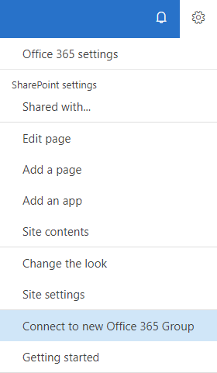
Connect to a Microsoft 365 group
How to go about it
SharePoint user interface
Programmatically
Learn, Analyze, Modernize
1
1
2
What happens?
A new Office 365 group is created, and that group is connected to your site collection
A new modern home page is created on your site and set as the site's home page
The group's Owners are now the site collection administrators
The group's Owners are added to your site's Owners group
The group's Members are added to your site's Members group
2
Notes:
Connect to an Office 365 Group:
https://docs.microsoft.com/en-us/sharepoint/dev/transform/modernize-connect-to-office365-group

Slide 23
Branding

Slide 24
Modernize site branding
Leverage new tenant-controlled SharePoint theme as covered in Branding module
Applies company branding
Ability to hide other out-of-the-box themes
Future proof recommendation
Best Practice
Remediate pages with custom master page and alternative CSS
Run Modernization Scanner
Identify sites with custom master pages and alternative CSS
Revert them to default configurations
Leverage tenant-controlled SharePoint theming
Resources: leverage provided scanner and powershell
Notes:
Modernize Site Branding:
https://docs.microsoft.com/en-us/sharepoint/dev/transform/modernize-branding
SharePoint offers a series of default themes out-of-the-box that you can use, but if you want to push your company branding, we recommend that you create your company theme and hide the out-of-the-box themes. After that configuration is complete, your users can only select from the company SharePoint themes that you've configured, and you can programmatically set such themes as part of the modernization effort.
Why remediate:
Modern experience simply ignores custom master pages or alternate CSS configurations (which are incompatible in the modern user interface).
ou can opt to leave these configurations in place in your modernized site so that it still applies to a page being shown in a classic user interface, but it's cleaner to switch back the OOB master pages and remove the alternate CSS configuration.

Slide 25
Transform Site Pages

Slide 26
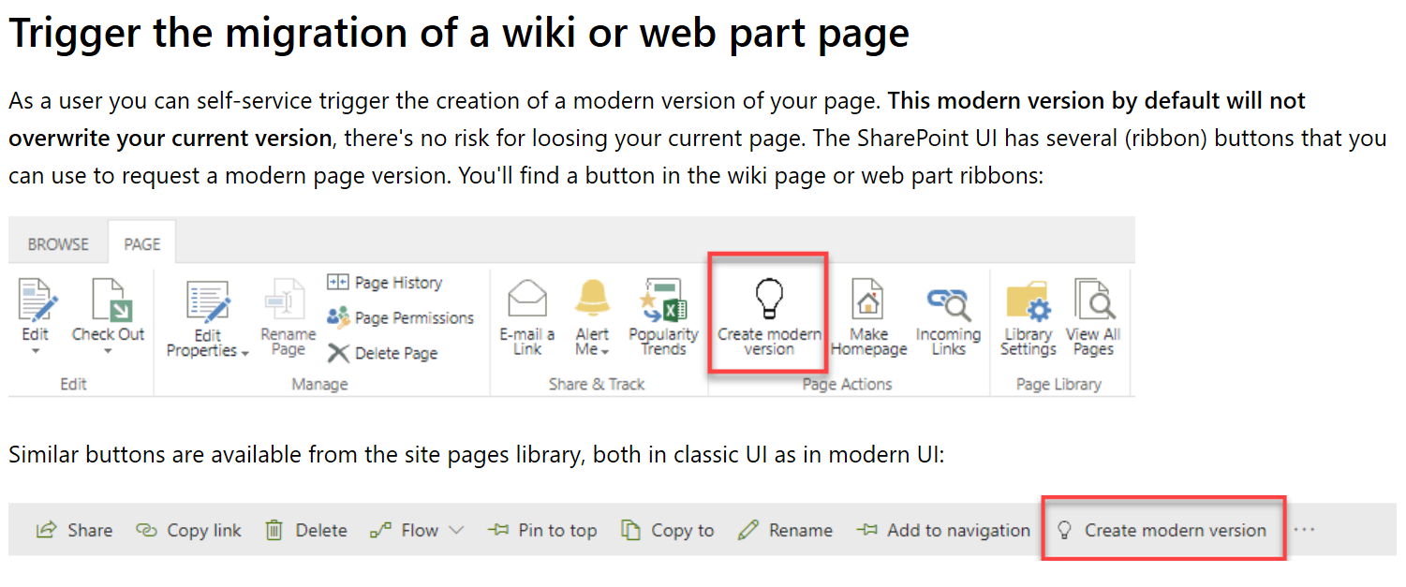
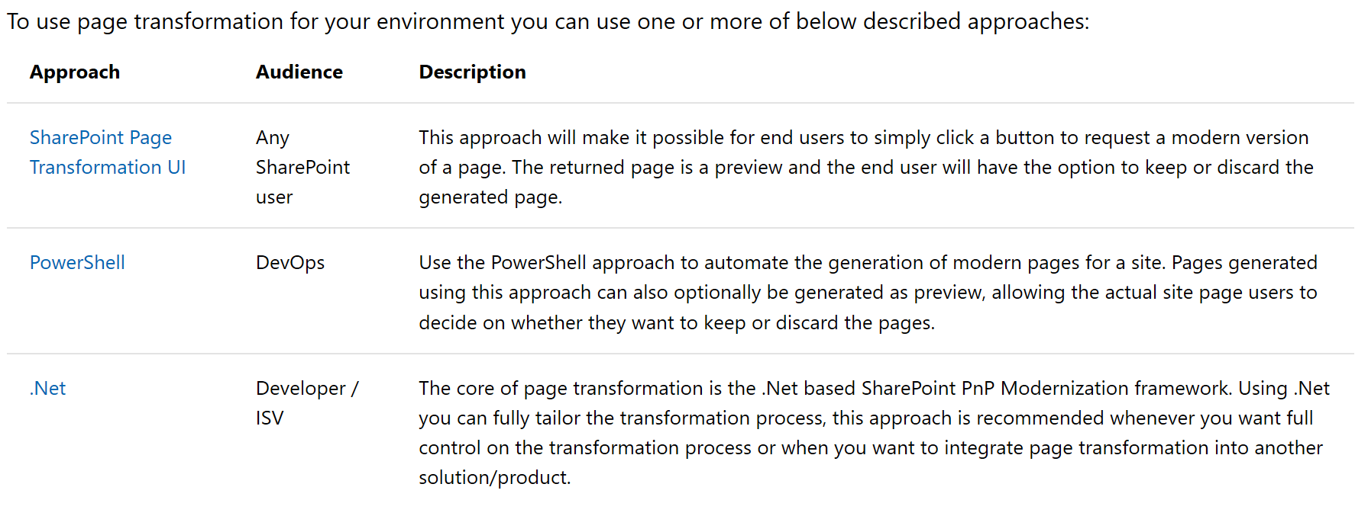
Transform site pages
Scope: Wiki and Web Part pages
Considerations
Preview capabilities
Partner best practice – leverage PowerShell approach
Notes:
Transform Site pages: https://docs.microsoft.com/en-us/sharepoint/dev/transform/modernize-userinterface-site-pages

Slide 27
Connect to a Microsoft Team

Slide 28
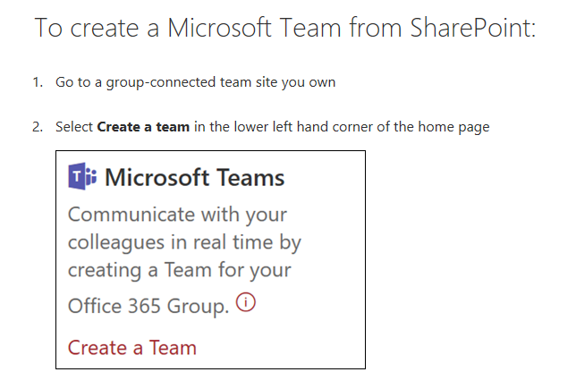
Connect to a Microsoft Team

Slide 29

Demonstration:
Show how to create a new site using a team template and then Teamify using the Microsoft Teams button.
Discuss: When would collaboration sites be used over Portal sites in your company
Notes:
In this demonstration, you will learn how to check a failed patch

Slide 30
Recommended Reading
Modernize your classic SharePoint sites | Microsoft Docs
Modernize the user interface | Microsoft Docs
The SharePoint modernization scanner | Microsoft Docs
SharePoint modernization guidance | Microsoft Docs

Slide 31
Knowledge Check
What tools are available to show readiness of classic sites to become modern?
What two strategic options do you have to connect to a Group?
What two levels of membership are available when a team site is group connected?
SharePoint Modernization Scanner
Each site owner to run a wizard
Owners
Run a bulk operation known as a group-connection
Members
Notes:
IIS logs, Event logs, URLScan, Netmon Traces, ULS logs

